Slide 1

Shape A
4 cm
15.75cm
8.25cm
Shape B
4 cm
8.25cm
H=2.5cm
15.75cm
7.75 cm
1
2
L=7.5cm
3
4 cm
W=1.5cm

Slide 2
Shape A

Slide 3
Shape B

Slide 4
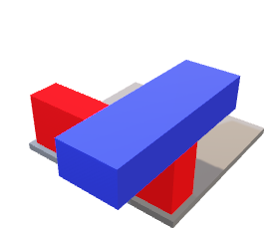
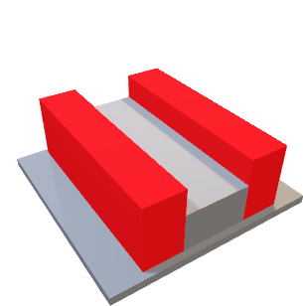
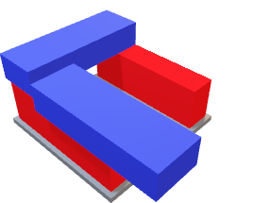
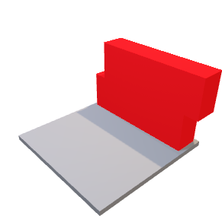
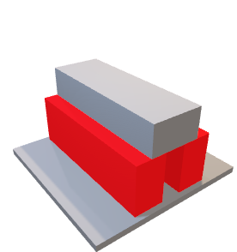
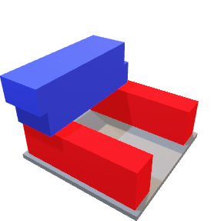
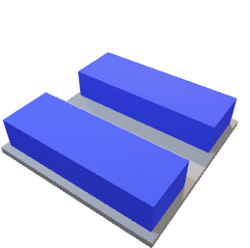
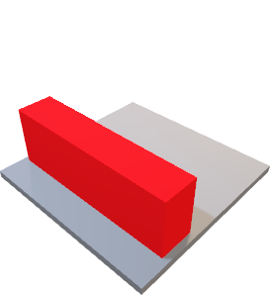
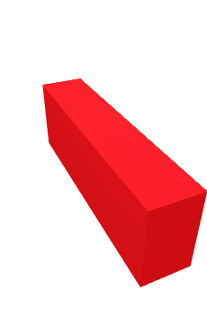
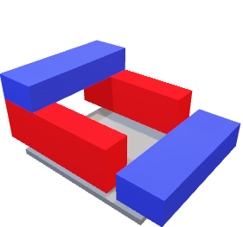
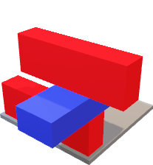
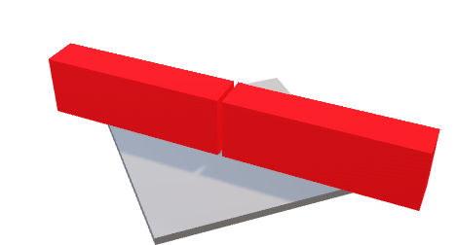
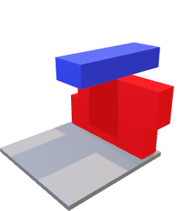
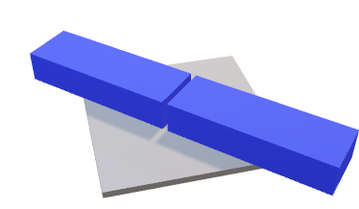
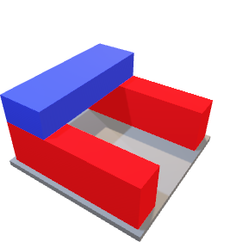
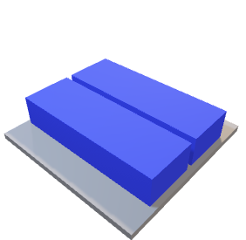
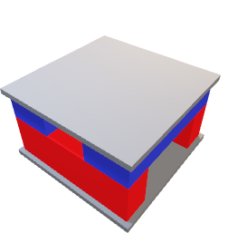
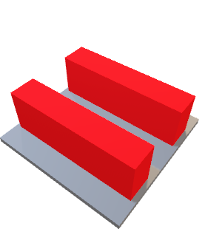
Rule 1
1) Protons are on side 1, parallel, spaced 2cm unless paired | 2) Neutrons are on side 2, perpendicular to protons, and can touch | 3) Protons start on starting platform
4) Build protons or neutrons on top of starting proton(s). Structure must be free-standing | 5) Levels only contain one nucleon type (protons or neutrons) | 6) Magic number pieces added when 2, 8, 20, and 28 are reached for one nucleon type
Protons must be on side 1 and spaced 2.5cm apart EXCEPT at their ends where they can pair
Example of rules 1-6
No Spacing
Spacing
Rule 4, 5
Start!
Rule 4, 5
Pairing
H=2.5cm
1
2
B2
3
B1
B3
L=7.5cm
Rule 4, 5
Rule 1, 3
Rule 4, 5
W=1.5cm
Rule 2
Neutrons can be in any orientation on side 2
Rule 5
Rule 3-5
Rule 2c
Shared proton and neutron level (Bad)
Neutron perpendicular to other neutron (Bad)
Rule 3-5
Rule 3-6
B2
continued
Shell closure (cardboard added)!

Slide 5

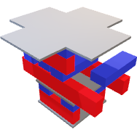



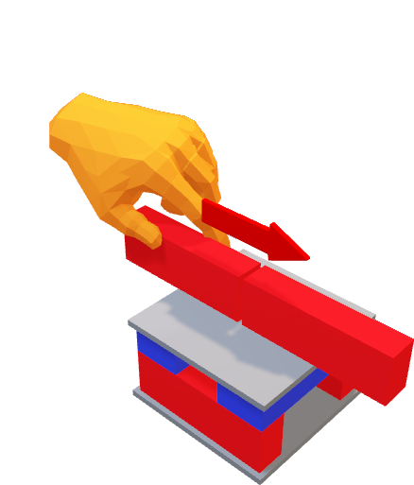
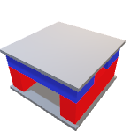
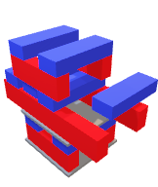
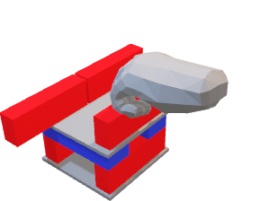


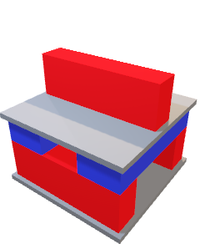

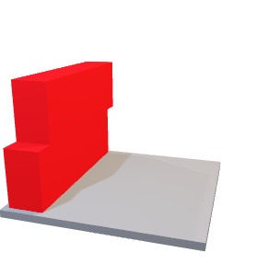

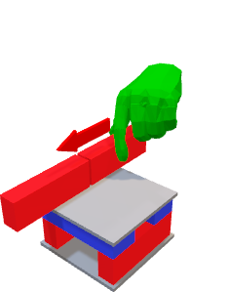
Extra Rules
Example game
1. Using one hand only, players may:
i. All players have placed 1 block down making ⁴He. Blue placed magic number
ii. Orange places proton on closed ⁴He
Add a nucleon
OR
Excite an existing nucleon
OR
iii. Green pairs proton on ⁵Li making ⁶Be
iv. Grey adds proton on ⁶Be making ⁷B
Pair a nucleon by sliding it
v. Blue excites proton on ⁷B
vi. Orange excites proton on ⁷B
2. Nucleons cannot be de-excited
vii. Nucleus decays after Orange plays!
Scoring:
Point Values for decay types:
Nucleon emission (N): +1 point
β or γ-decay (β, γ): +2 points
Magic Numbers (M): +1 point per board on nucleus
Add all points from decayed nucleons and any magic numbers in play. Total goes to the player who played the last stable move. GOAL: First to 25 wins!
Ex: It decayed on Orange’s turn, so Blue will get the points. We have two protons which fell onto their sides, β-decaying into two neutrons. Blue gets 2(β)+2(β)+1(M)=5 points!
3. Once the minimum number of protons and neutrons have been added, a player may add a Magic Number board
Example: 8 protons and 8 neutrons
Blue wins the round!

Slide 6
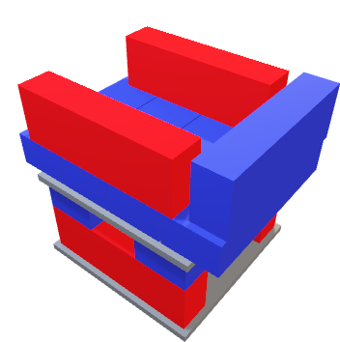
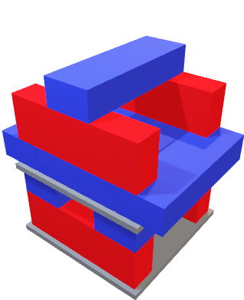
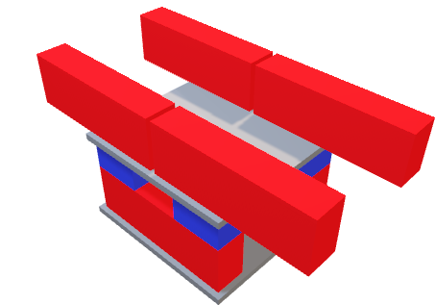
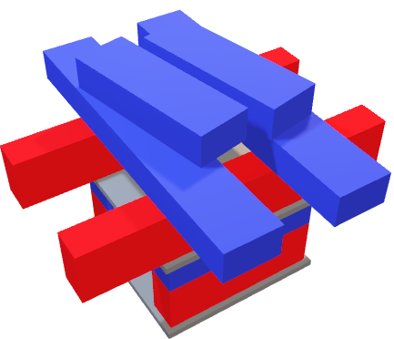
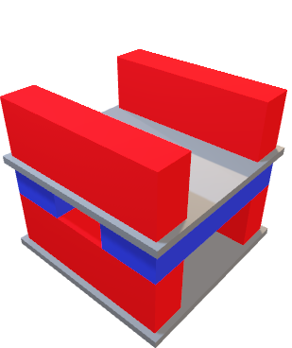
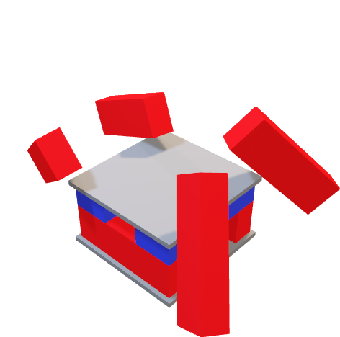
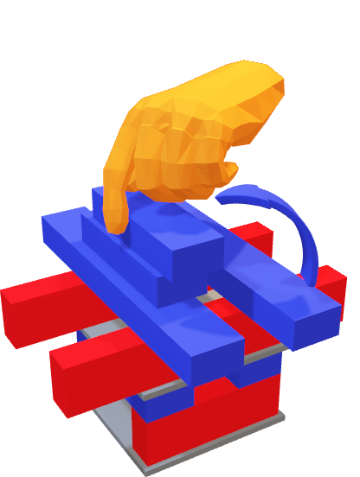
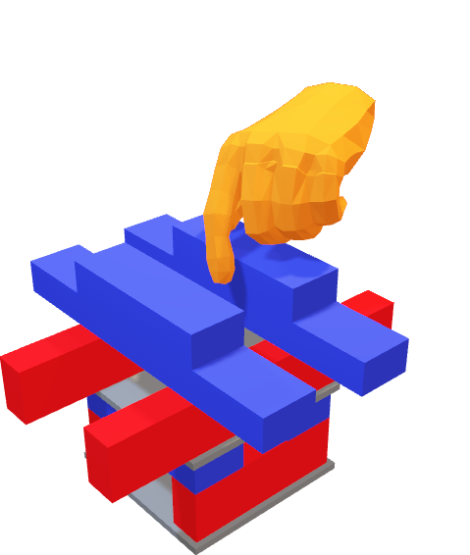
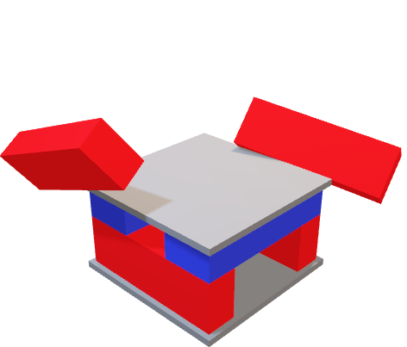
γ decay
Excited state of ¹⁴C
Gamma Emission of ¹⁴C
2) Move a nucleon!
Add vibrations!
3) Watch the decay! Notice the neutron is in the same flat orientation
1) Build your nucleus (¹⁴C)
β decay
The neutron is now in the same orientation as the protons, so it becomes a proton too.
You made ¹¹B!
Add vibrations!
Ground state of ¹¹Be
Nucleon emission
⁸C (2 neutrons to 6 protons)
Decays with 4 proton emission!
Add vibrations!
⁶Be (2 neutrons to 6 protons) Decays with 2 proton emission!
Add vibrations!

Slide 7
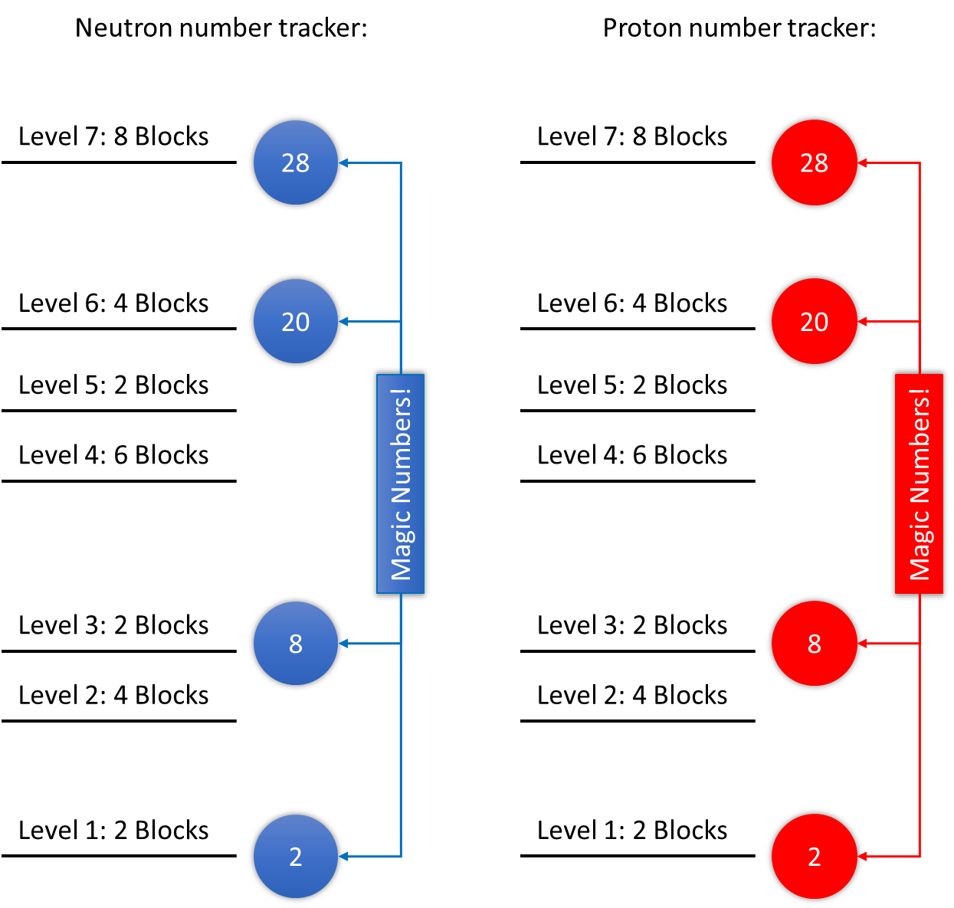
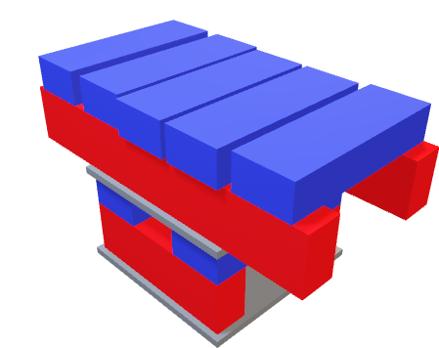
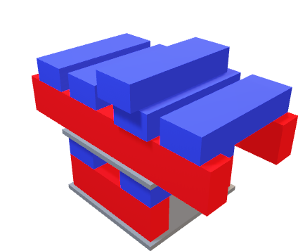
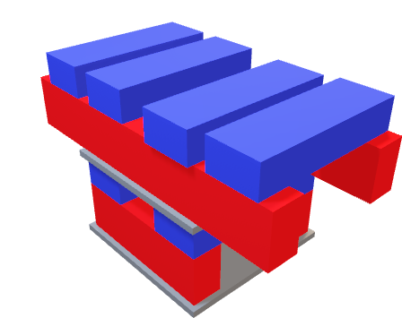
(Optional) Rule 7
If following rule 7

Slide 8
Neutron number tracker:
Proton number tracker:
Level 7: 8 Blocks
28
Level 7: 8 Blocks
28
Level 6: 4 Blocks
20
Level 6: 4 Blocks
20
Level 5: 2 Blocks
Level 5: 2 Blocks
Level 4: 6 Blocks
Level 4: 6 Blocks
Magic Numbers!
Magic Numbers!
Level 3: 2 Blocks
8
Level 3: 2 Blocks
8
Level 2: 4 Blocks
Level 2: 4 Blocks
Level 1: 2 Blocks
2
Level 1: 2 Blocks
2

Slide 9
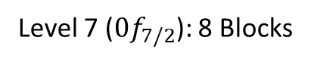
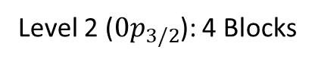
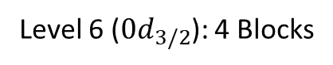
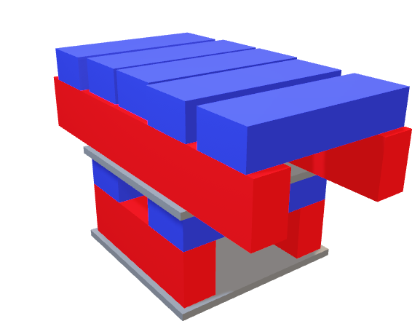
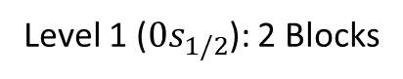
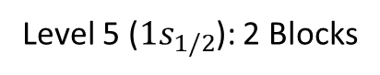
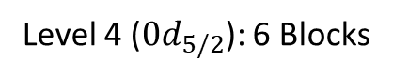
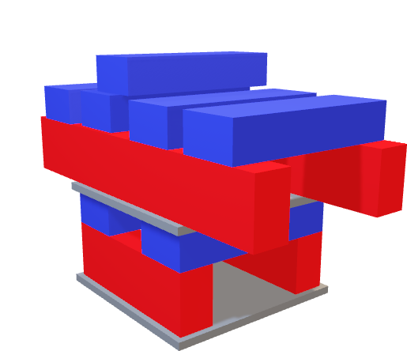
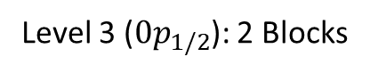
1 Level 3 block!
Rule 7 Example
4 Level 2 blocks!
Valid number of blocks in each level!
Nucleon number tracker:
Level 7 ($0f_{7/2}$): 8 Blocks
28
Level 6 ($0d_{3/2}$): 4 Blocks
20
4 Level 2 blocks!
2 Level 1 blocks!
Level 5 ($1s_{1/2}$): 2 Blocks
2 Level 1 blocks!
Level 4 ($0d_{5/2}$): 6 Blocks
Magic Numbers!
5 Level 2 blocks!
4 Level 2 blocks!
Level 3 ($0p_{1/2}$): 2 Blocks
8
Too many blocks in neutron level 2!
Level 2 ($0p_{3/2}$): 4 Blocks
Level 1 ($0s_{1/2}$): 2 Blocks
2
2 Level 1 blocks!
2 Level 1 blocks!

Slide 10
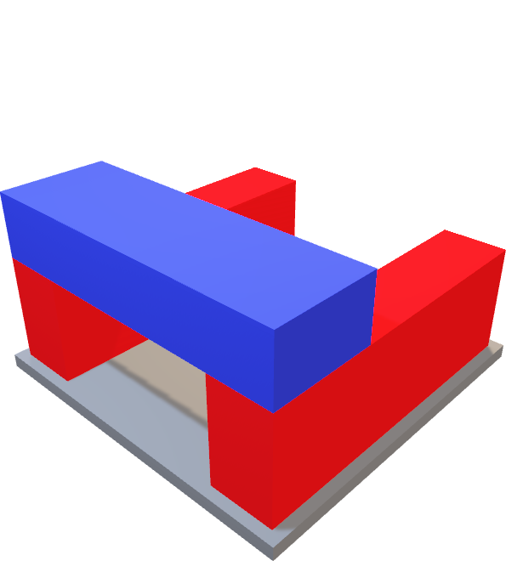
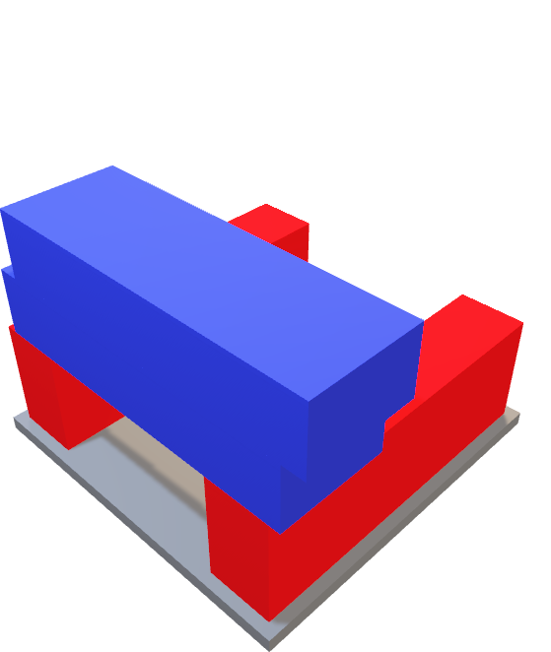


Slide 11









1. Using one hand only, players may:
2. Nucleons cannot be de-excited
Add a nucleon
OR
Excite an existing nucleon
3. Once the minimum number of protons and neutrons have been added, a player may add a Magic Number board
Scoring:
Point Values:
Nucleon emission = 1 point
β or γ-decay = 2 points
Magic Numbers = +1 point per board on nucleus
When the nucleus decays, all points from that round go to the player who played the last stable move
Example: 8 protons and 8 neutrons
i. All players have placed 1 block down making ⁴He. Blue placed magic number
ii. Orange, Green, & Black place protons on top of closed ⁴He
iii. Blue excites a proton
iv. Orange caused stack to fall by exciting a proton
Scoring: Since protons are on their sides and still on the nucleus, this was β-decay (2 points). Total points: 2 (β-decay) + 1 Magic number = 3 points for Blue!

Slide 12



γ decay
Excited state of ¹⁴C
Gamma Emission of ¹⁴C
2) Move a nucleon!
Add vibrations!
3) Watch the decay! Notice the neutron is in the same flat orientation
1) Build your nucleus (¹⁴C)
β decay
The neutron is now in the same orientation as the protons, so it becomes a proton too.
You made ¹¹B!
Add vibrations!
Ground state of ¹¹Be
Nucleon emission
⁸C (2 neutrons to 6 protons)
Decays with 4 proton emission!
Add vibrations!
⁶Be (2 neutrons to 6 protons) Decays with 2 proton emission!
Add vibrations!

Slide 13












1. Neutrons (Blue) always go down first AND must be pointed the same direction
2. Protons (Red) can go next, but you must leave 1 block’s space between them!
3. Each level must be separate from other levels for protons and neutrons
4. If you’ve hit a magic number on your tracker, you get a piece of cardboard!
5. You do not get a piece of cardboard if you haven’t filled up the levels for BOTH protons and neutrons.
6. Once you start a new level, you cannot add any more to the previous level!
7. Remember, at each new level, neutrons go first! They also CAN go next to each other!
8. Don’t forget to update your tracker as you go!
5 Neutrons!
2 Protons!
5
2

Slide 14







Fun physics topics
1 proton emitter is when 1 red block falls off. Can you make a more complicated version?
2 proton emitter is when 2 red blocks falls off. Can you make a more complicated version?
2 proton emitter is when 2 red blocks falls off. Can you make a more complicated version?
Excited states are when you move one block up to a higher level. It makes everything more unstable and, well, exciting!
Hoyle State!
Take 3 sets of ⁴He and stack them together. Notice that it needs you to spend energy stacking them, so it’s not the easiest way to make ¹²C! What else can you make?

Slide 15




Goals and Physics
1 particle emitter is when 1 block falls off. Can you make a more complicated version?
2 particle emitter is when 2 blocks falls off. Can you make a more complicated version?
3 particle emitter is when 3 blocks falls off. Can you make a more complicated version?
Excited states are when you move one block up to a higher level. It makes everything more unstable and, well, exciting!
Hoyle State!
Take 3 sets of ⁴He and stack them together. Notice that it needs you to spend energy stacking them, so it’s not the easiest way to make ¹²C! What else can you make?
GOAL: Try to build the largest nucleus
or build the most exotic nucleus (lots more protons or neutrons) you can!
But watch out, Quantum Mechanics might just vibrate your nuclei apart!

Slide 16











1. Neutrons (Blue) always go down first AND must be pointed the same direction
2. Protons (Red) can go next, but you must leave 1 block’s space between them!
3. Each level must be separate from other levels for protons and neutrons
4. If you’ve hit a magic number on your tracker, you get a piece of cardboard!
5. You do not get a piece of cardboard if you haven’t filled up the levels for BOTH protons and neutrons.
6. Once you start a new level, you cannot add any more to the previous level!
7. Remember, at each new level, neutrons go first! They also CAN go next to each other!
GOAL: Try to build the largest nucleus or build the most exotic nucleus (lots more protons or neutrons) you can!
But watch out, Quantum Mechanics might just vibrate your nuclei apart!

Slide 17









1. Protons (Red) go down first, must be pointed the same direction, placed up on their sides, AND be spaced 1 block width apart.
2. Neutrons (blue) can go next! They must point the other direction from protons.
3. Each level must be separate from other levels for protons and neutrons
4. If you’ve hit a magic number, you get a piece of cardboard!
5. (Optional) Each level has a maximum number of blocks allowed; you cannot place more than is listed for each level. Levels don’t need to go in order on the diagram, but magic numbers might change!
1 proton in proton Level 2
2 protons in proton Level 1
2 neutrons in neutron Level 1
3 protons in proton Level 1
2 neutrons in neutron Level 1

Slide 18





1. Protons (Red) go down first, must be pointed the same direction, placed up on their sides, AND be spaced 1 block width apart.
2. Neutrons (blue) can go next! They must point the other direction from protons.
3. Each level must be separate from other levels for protons and neutrons
4. If you’ve hit a magic number, you get a piece of cardboard!

Slide 19




Unique states!
Ground state of ⁵Li
Excited state of ⁵Li
Rare Isotopes!
⁵H (4 neutrons to 1 proton)
⁸C (2 neutrons to 6 protons)

Slide 20










1. Using one hand only, players may:
2. Nucleons cannot be de-excited
Add a nucleon
OR
Excite an existing nucleon
3. Once the minimum number of protons and neutrons have been added, a player may add a Magic Number board
Scoring:
Point Values:
Nucleon emission = 1 point
β or γ-decay = 2 points
Magic Numbers = +1 point per board on nucleus
When the nucleus decays, all points from that round go to the player who played the last stable move
Example: 8 protons and 8 neutrons
i. All players have placed 1 block down making ⁴He. Blue placed magic number
ii. Orange, Green, & Black place protons on top of closed ⁴He
iii. Blue excites a proton
iv. Orange caused stack to fall by exciting a proton
Scoring: Since protons are on their sides and still on the nucleus, this was β-decay (2 points). Total points: 2 (β-decay) + 1 Magic number = 3 points for Blue!

Slide 21









1. Protons (Red) go down first, must be pointed the same direction, placed up on their sides, AND be spaced 1 block width apart.
2. Neutrons (blue) can go next! They must point the other direction from protons.
3. Each level must be separate from other levels for protons and neutrons
4. If you’ve hit a magic number, you get a piece of cardboard!
5. (Optional) Each level has a maximum number of blocks allowed; you cannot place more than is listed for each level. Levels don’t need to go in order on the diagram, but magic numbers might change!
1 proton in proton Level 2
2 protons in proton Level 1
2 neutrons in neutron Level 1
3 protons in proton Level 1
2 neutrons in neutron Level 1

Slide 22












1. Blue and orange have each placed 1 proton
3. Black cannot de-excite the block and can only add a new block
2. Green chooses to excite 1 proton
4. Blue placed proton on top, causing the nucleus to fall apart. Since a nucleon fell off the platform (nucleus) it was nucleon emission. Total points: 1 (nucleon emission) = 1 point for Black!
1. All players have placed 1 block down making ⁴He. Blue placed magic number (adds 1 extra point to end decay)
4. Orange tries to excite the other proton, causing the stack to fall. Since protons are on their sides and still on the nucleus, this was β-decay (2 points). Total points: 2 (β-decay) + 1 Magic number = 3 points for Blue!
3. Blue excites a proton
2. Orange, Green, & Black place protons on top of closed ⁴He
2. Since ¹⁶O has 8 protons and 8 neutrons, Orange chooses to place the magic number which closes the shells.
3a. Green excites a proton from below the closed shell. IS ALLOWED
1. Players have made ¹⁶O.
3b. Green places a proton below the magic number, inside the closed shell. This IS NOT ALLOWED. Once a shell is closed, you cannot add any more nucleons unless one has been excited outside the closure.

Slide 23




1. Blue player places a proton
2. Orange player can place a proton or neutron (chooses proton)
4. Black player can either excite a block or add a new one. Chooses to add a neutron.
3. Green player can either:
a. Add a new block (type of their choice)
b. Excite an existing block
3. Black player can either:
a. Add a new block (type of their choice)
b. Excite an existing block
5. Blue Player can excite a block, add a block or fill the magic number

Slide 25


Nuclear building blocks

Slide 26

Nuclear building blocks

Slide 27

Did you just make a Nuclear Discovery?!
???
Click the “Discovery Submissions” tab to submit your work for peer-review.

Slide 28






Slide 29




Slide 30

Unknown
Decay Mode

Slide 31

Spontaneous Fission

Slide 32





Slide 34












Slide 36








Slide 37




Slide 38


